Slide 1
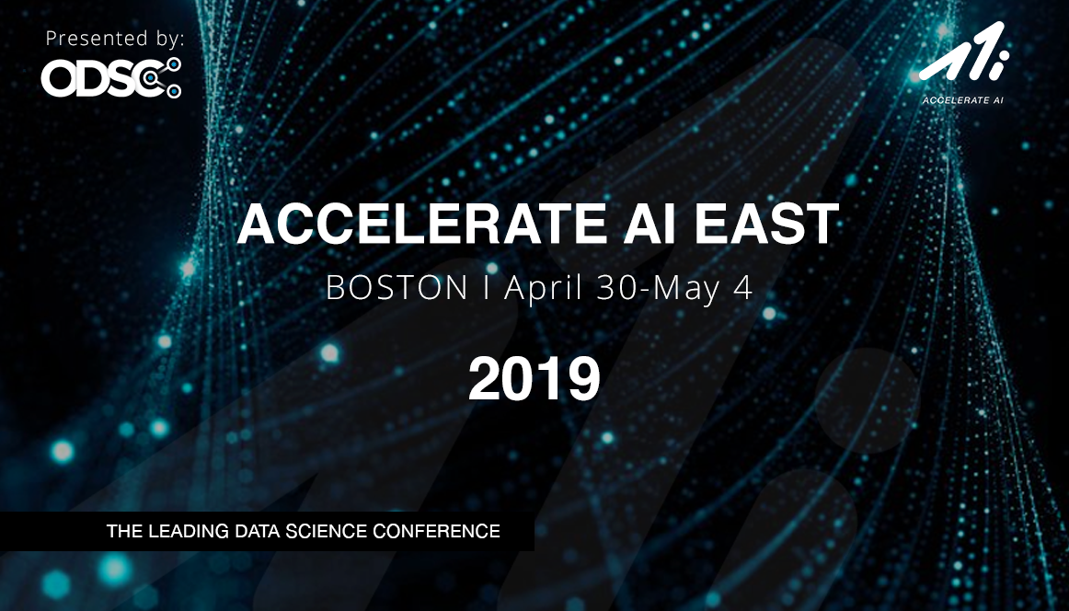
OPEN
DATA
SCIENCE
CONFERENCE
@ODSC

Slide 2
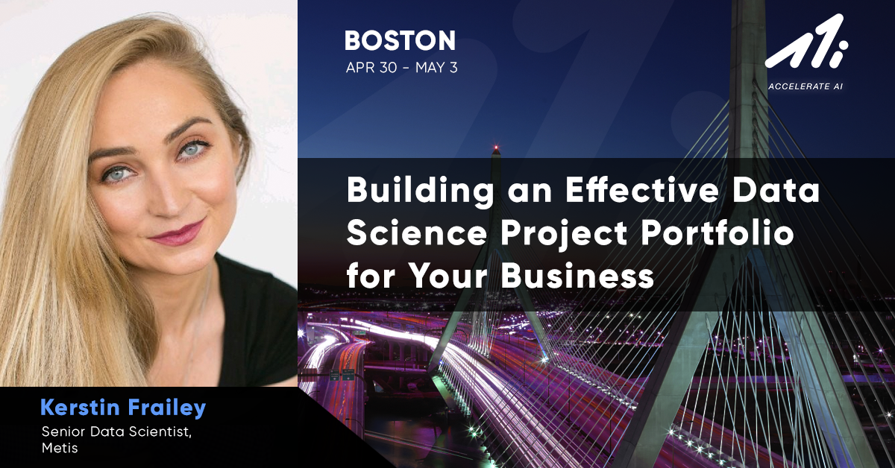

Slide 3


How to Build an Effective
Data Science Portfolio
for Your Business

Slide 4

KERSTIN FRAILEY
Senior Data Scientist, Metis
“[Statistics is] just a whole bunch of answers to word problems no one ever bothers to tell you”
Data science leadership in all three sectors: for-profit, non-profit, and government
Develop and deliver curriculum to accelerate data science learning for technical and non-technical teams
Graduate degrees from Cornell University and University of Illinois at Chicago, University of Chicago data science fellow

Slide 5
Expert Data Science Training to Strengthen Your Business.
Your employees know your use cases, infrastructure, and stack. We provide training to fill in the gaps, enabling your organization to capitalize on the potential
already working under your roof.
Notes:
We realized that companies needed to grow data scientists internally instead of waiting for them to grow themselves. And with their data scientists, we are there to help the rest of the team be ready to make the most of the DS, by training managers to analysts and to delivery data literacy for your entire team.

Slide 6

Building an Effective Data Science Portfolio
Challenges & Opportunities
PITCH
SCOPE
PLAN
Evolve

Slide 7

Challenges & Opportunities
Bring the problem, not the solution

Slide 8
Challenges & Opportunities
Identify places for improvement or new opportunities
Do not come with the solution; Come with the problem
Ideas should come from all types of stakeholders
Ideas should be impact focused, not data science focused
Generate as many ideas as possible

Slide 9

PITCH
The booster club for business impact

Slide 10
PITCH
Preliminary Scoping
Pitching
Winnowing

Slide 11
Preliminary Scoping
Done by the person pitching, possibly in conjunction with a technical member
Should identify:
The impact (obstacle or opportunity)
A potential impact hypothesis
Major/obvious risks
Compile scoped ideas for pitching

Slide 12

Pitching
Open meeting with all people behind pitches
“Elevator pitch party”
Generate excitement
Focus on potential, be optimistic

Slide 13

Winnowing
Done by major stakeholders and managers
From pitched ideas, select those to be fully scoped
Make sure to incorporate:
Excitement-generating ideas
“Boring” ideas that are potentially high impact
Strategic ideas

Slide 14

SCOPE
An ounce of scoping is worth a pound of fixing the stuff you broke while you were moving fast

Slide 15
SCOPE
Technical
Nontechnical
In-Between
Document, Share,
and Save

Slide 16

Technical Scoping
Done by the technical members of the team
Beyond the standard technical scoping
Data science scoping should lay out potential solution paths, e.g. data science project, and estimates of performance for those paths:
Not all potential solutions should be data science-y
Data science solutions should provide reasonable estimates for poor, excellent, and good performance in terms of data science metrics (e.g. accuracy or precision)

Slide 17
Nontechnical Scoping
Performed by managers and stakeholders
Identify and document the Impact Hypothesis
Identify all potentially impacted parties, both internal and external:
E.g. will customer service get a surge of new calls? Will finance need to adjust models for dynamic pricing?
Identify positive and negative impacts of success, as well as positive and negative impacts of failure
Define Success
Notes:
positive and negative impacts of success -- chatbot reduces personell costs, but might upset people who like to talk to a real person
positive and negative impacts of failure:: humans can spot patterns in CS issues, losing customers we’re directing poorly

Slide 18

Somewhere In-Between Scoping
This is a balance of analysis, data science, and business knowledge
Working collaboratively, you should:
And size the business impact driven by reasonable performance of a data science solution
Size
Obstacle or Opportunity
The costs to failure types
The benefits of success types
Identify
The status quo
The unknowns

Slide 19
Somewhere In-Between Scoping:
Example
Example: Introduce Customer Service Chatbot
The Obstacle or Opportunity: X number of CS issues per month can be answered by FAQs
The costs to failure types: Lost high LTV customer $, lost low LTV customer $
The benefits of success types: $ in personnel costs at A, B, C% capture of X
The status quo: Direct all CS issues to humans
The unknowns: How well can we identify relevant FAQ, customers’ preference to human interaction, effectiveness of FAQs
...

Slide 20
Somewhere In-Between Scoping:
Example
Example: Introduce Customer Service Chatbot (continued)
Size the business impact that reasonable performance of data science solution would have:
Capture Y% of X relevant CS issues
Incorrectly capture Z% of other CS issues
Results in $$ saved in personnel costs
Results in $$ risked in customer retention

Slide 21

Document, Share, & Save
Scoping takes a long time
The world changes, obstacles go away, resources open up, and infrastructure is built
Projects may become possible or preferable that previously weren’t
Don’t redo the scoping that doesn’t need to be redone
Do redo the scoping that does need to be done

Slide 22

PLAN
Like mapping a road trip for a destination that’s going to change

Slide 23
PLAN
Plot
Path
Select
Document, Share,
and Save

Slide 24
Plot
X: Cost - With a range
Y: Benefit - With a range
Size: Risk - Unknown-ness at critical points

Slide 25

BENEFIT
COST
Notes:
Color encode to your choice (teams work done by, stakeholders, excitement, etc)

Slide 26
Plot
X: Cost - With a range
Y: Benefit - With a range
Size: Risk - Unknown-ness at critical points
Links: Dependencies
What can act as a springboard for other projects
E.g. projects that rely on the same infrastructure

Slide 27
BENEFIT
COST

Slide 28

Path
Build potential roadmaps by connecting projects
A single path or a collection of paths represent a project portfolio

Slide 29
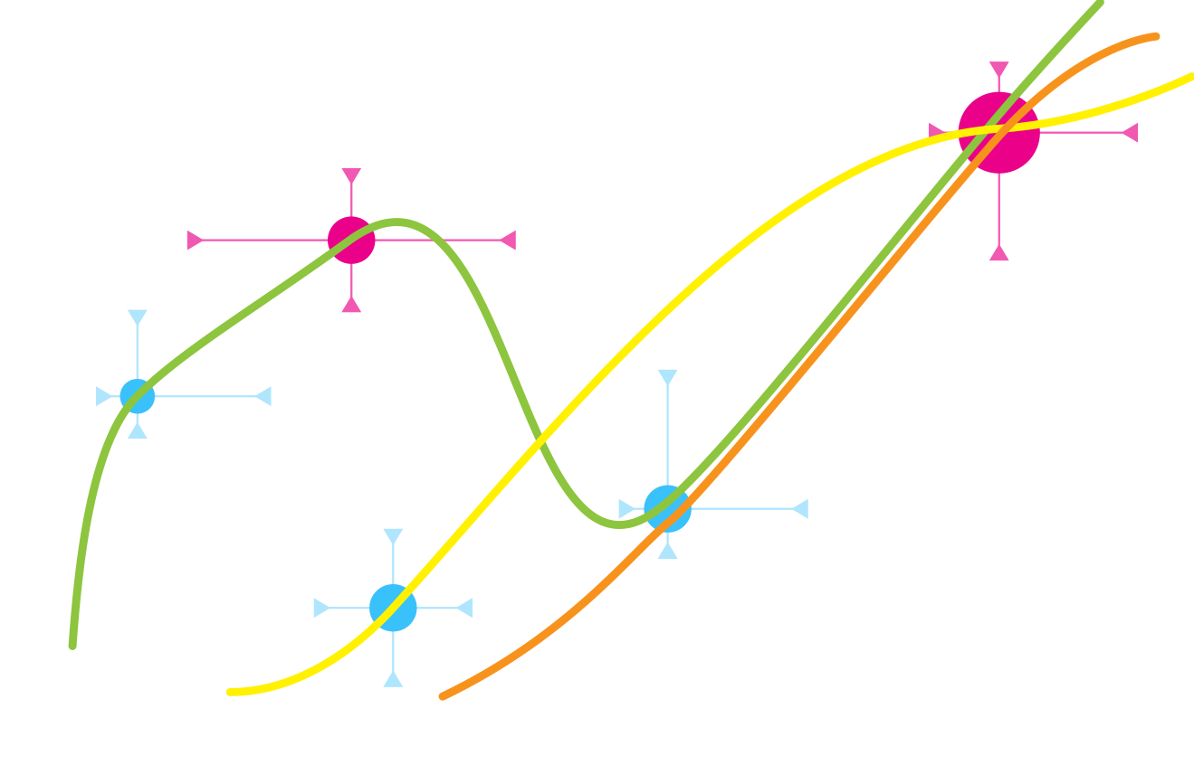
BENEFIT
COST

Slide 30
Path
Paths have cumulative benefit and potentially cumulative cost
Paths with interdependencies reduce overall cost, but not benefit
More teams working in parallel means more paths
And greater benefits and risks from dependencies
Data science project must be monitored and maintained; the more active projects, the more time needs to be dedicated to overall maintenance

Slide 31

Select
Paths that Balance exciting projects, boring high impact projects, and strategic projects
Exciting will keep teams engaged, though tend to be high risk
Paths with more intermediate steps show more value and allow for more flexibility
Each project is like a junction on a road trip—you can more easily change course and you can show how far you’ve come

Slide 32
Document, Share, & Save
Scoping takes a long time
The world changes, obstacles go away, resources open up, and infrastructure is built
Projects may become possible or preferable that previously weren’t
Don’t redo the scoping that doesn’t need to be redone
Do redo the scoping that does need to be done

Slide 33
Document, Share, & Save
Scoping Planning takes a long time
The world changes, obstacles go away, resources open up, and infrastructure is built
Projects may become possible or preferable that previously weren’t
Don’t redo the scoping planning that doesn’t need to be redone
Do redo the scoping planning that does need to be done

Slide 34

Evolve
The best laid plans

Slide 35
Evolve
The world changes, obstacles go away, resources open up, and infrastructure is built
Projects may become possible or preferable that previously weren’t
Fortunately, you’ve documented, shared, and saved your scoping and planning documents
So, when the future happens, you already have a plan

Slide 36
Building an Effective Data Science Portfolio
Challenges & Opportunities
PITCH
SCOPE
PLAN
Evolve

Slide 37
Join Metis for a live webinar event:
Start with Strategy: Building an Effective
Data Science Project Portfolio for Your Business
WEDNESDAY, MAY 15
1PM - 1:45PM ET
FREE!
To register, visit: ThisIsMetis.com/WEBINAR

Slide 38
Thank You
KERSTIN FRAILEY + METIS, CORPORATE TRAINING
kerstin.frailey@thisismetis.com

